Slide 1
SMK College of Applied Sciences:
Bachelor of International Trade and Customs logistics
Tomas Tamulevičius
Kaunas, Lithuania

Slide 2
HEY,
What is SMK?
SMK is introducing an alternative EXPERIENTIAL LEARNING METHOD where ideal balance of theoretical and practical knowledge correlates with personal evolution and strive for success. EXCEPTIONAL, interesting, outstanding studies are forming not only MODERN outlook of science but also learning environment. Our philosophy begins with recognizing the unique, special and UNLIMITED POTENTIAL of every student. SMK is a space for everyone to feel comfortable and inspired to become the best versions of themselves.
Established in 1994, SMK has grown to position itself at the very top of Lithuanian private college rankings and currently is the biggest private higher education institution in Lithuania.

Slide 3
30 Years
Of Experience
4700 Students
+500 International Students
3 Campuses:
Vilnius, Kaunas, Klaipeda
12 000 Alumni
11
International Professional Bachelor’s Study Programmes taught in English and 21 in Lithuanian
#smklife

Slide 4
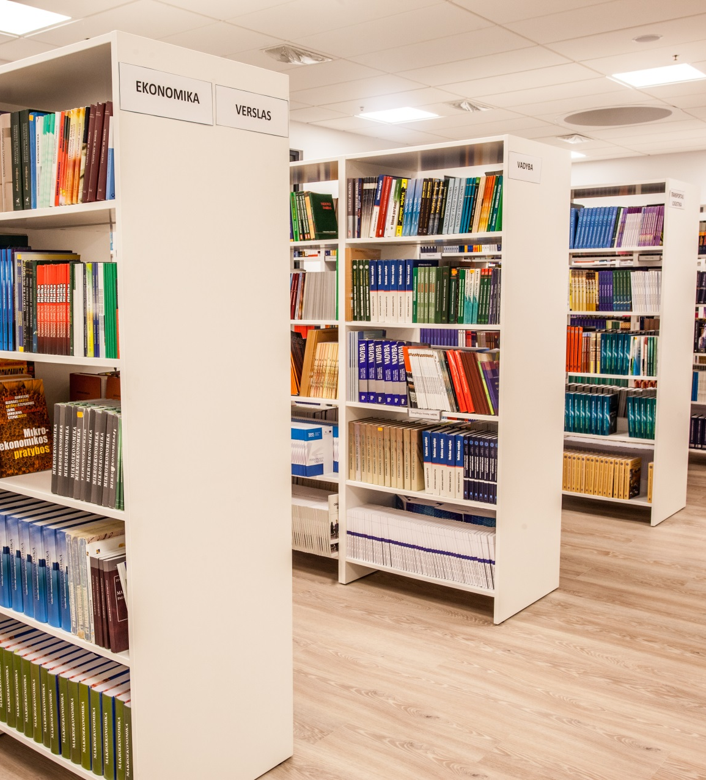
Studies at SMK
Study duration – 3 years
Degree obtained – Professional Bachelors (180 ECTS credits)
2 different internships during study period
Final thesis defense
Constant academic counseling
Erasmus+ student exchange opportunities
Scholarships available for best and most active students

Slide 5
Bachelor of International Trade and Customs logistics
Curriculum in short:
Finance Accounting and Taxes (VAT)
International Trade
E-trade
Customer client management
Customs Operational Competency for the private sector
Logistics and Supply Chain Management
Logistics Centres and Warehouse Activity
Technologies of Cargo and Goods Transportation
Information Systems in Transport Logistics and customs
Customs Activity and Procedures
Classification of Goods and Cargo
Customs Business understanding
Customs Management and supervision
International Customs Law
E- customs
Protection of Intellectual Property
Customs risks analysis
Notes:
S

Slide 6
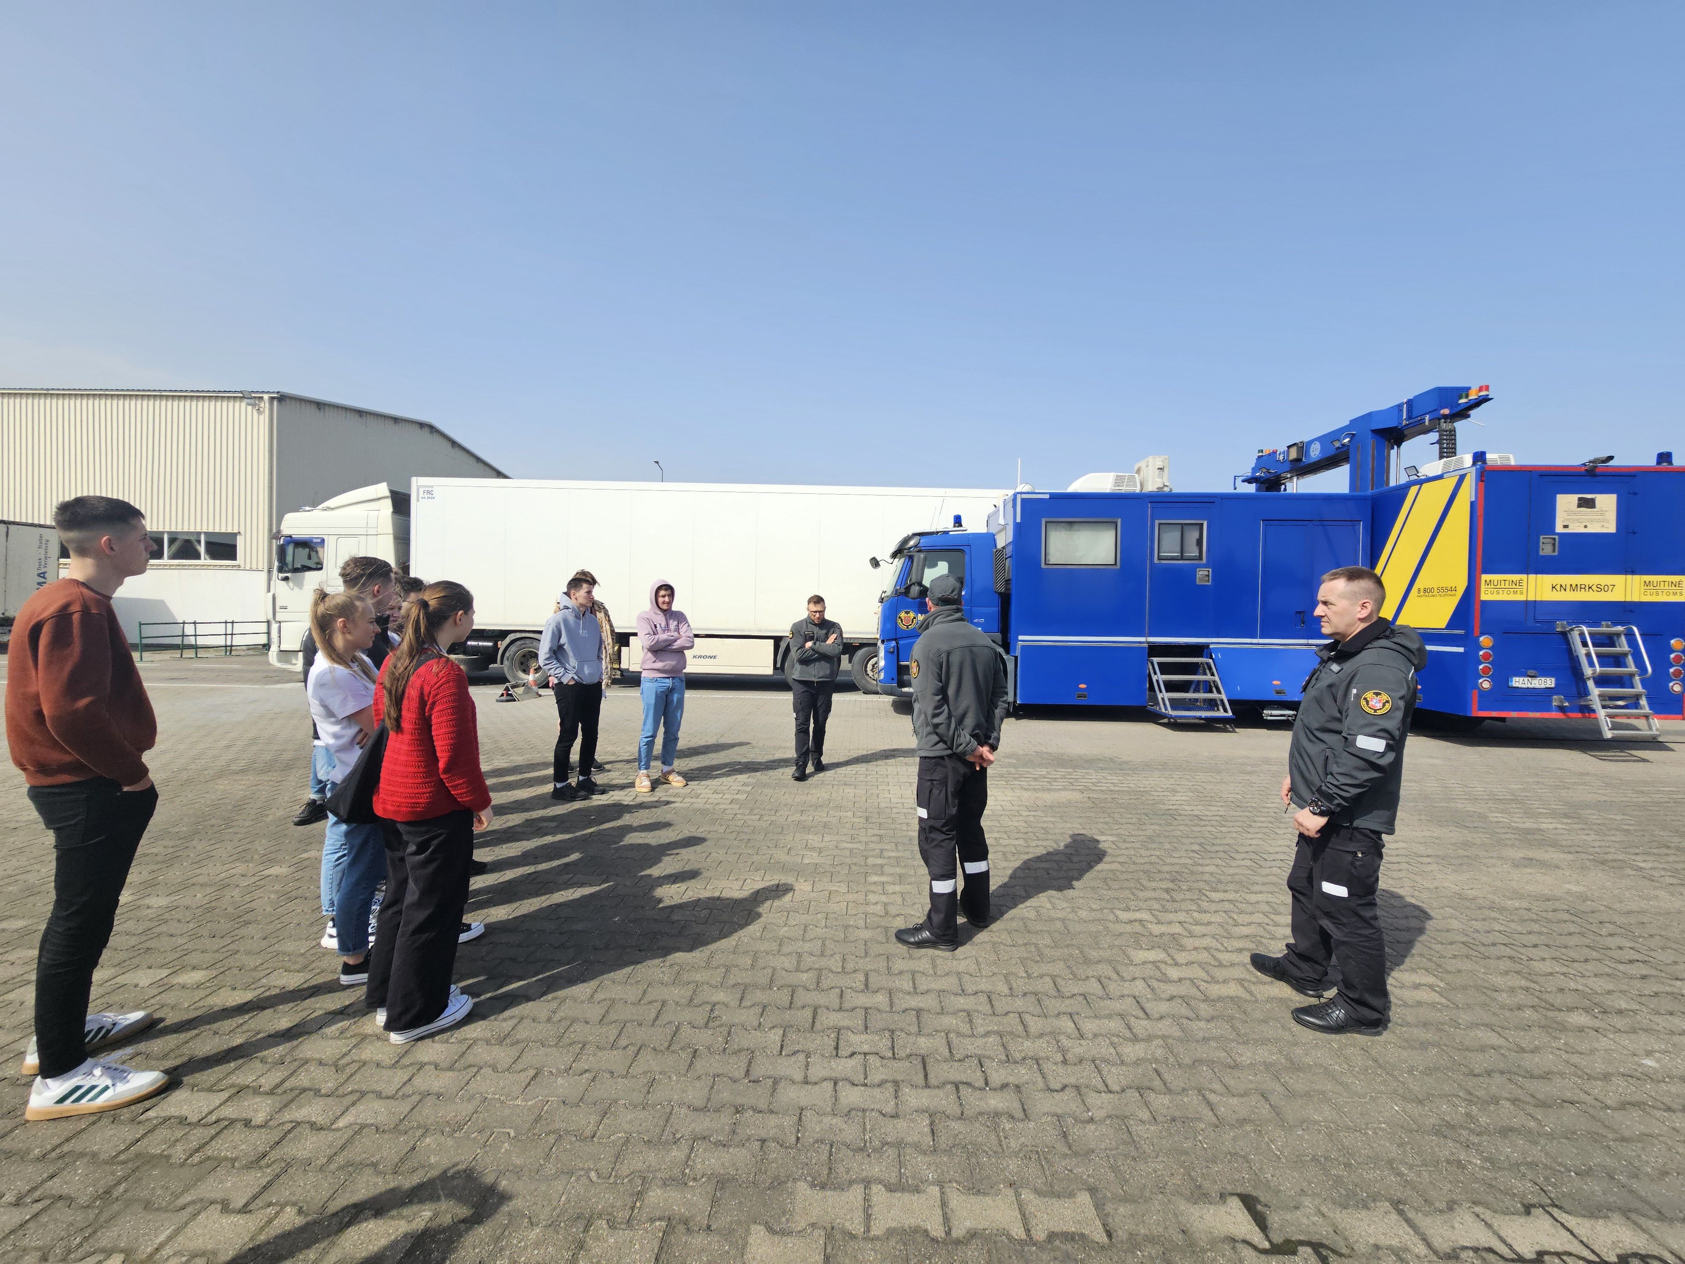
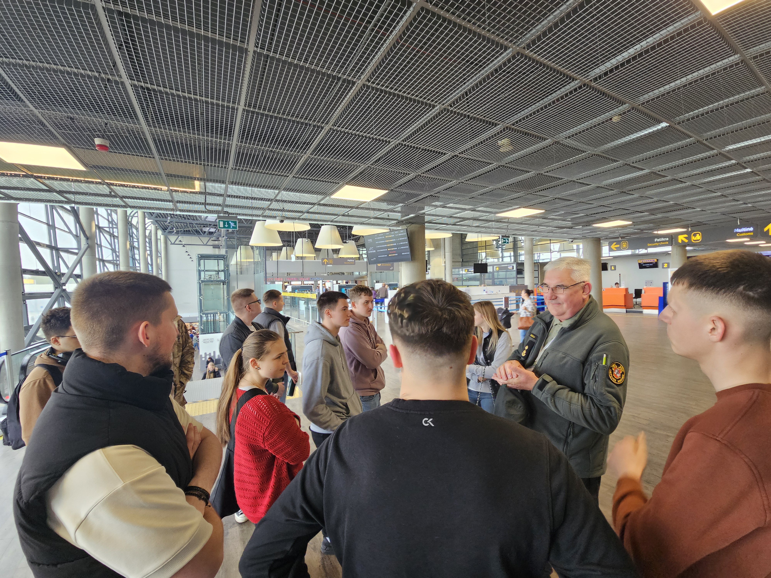
Foundation of studies: Integral connection with Lithuanian customs
Notes:
S

Slide 7
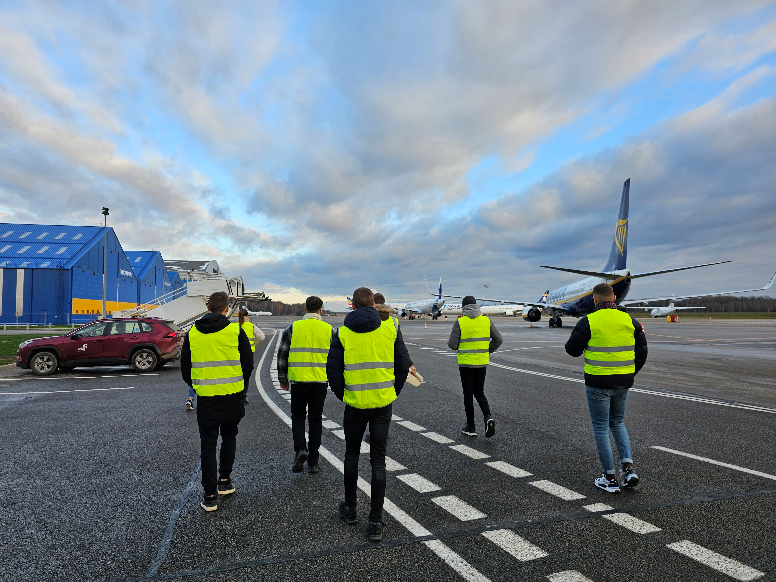
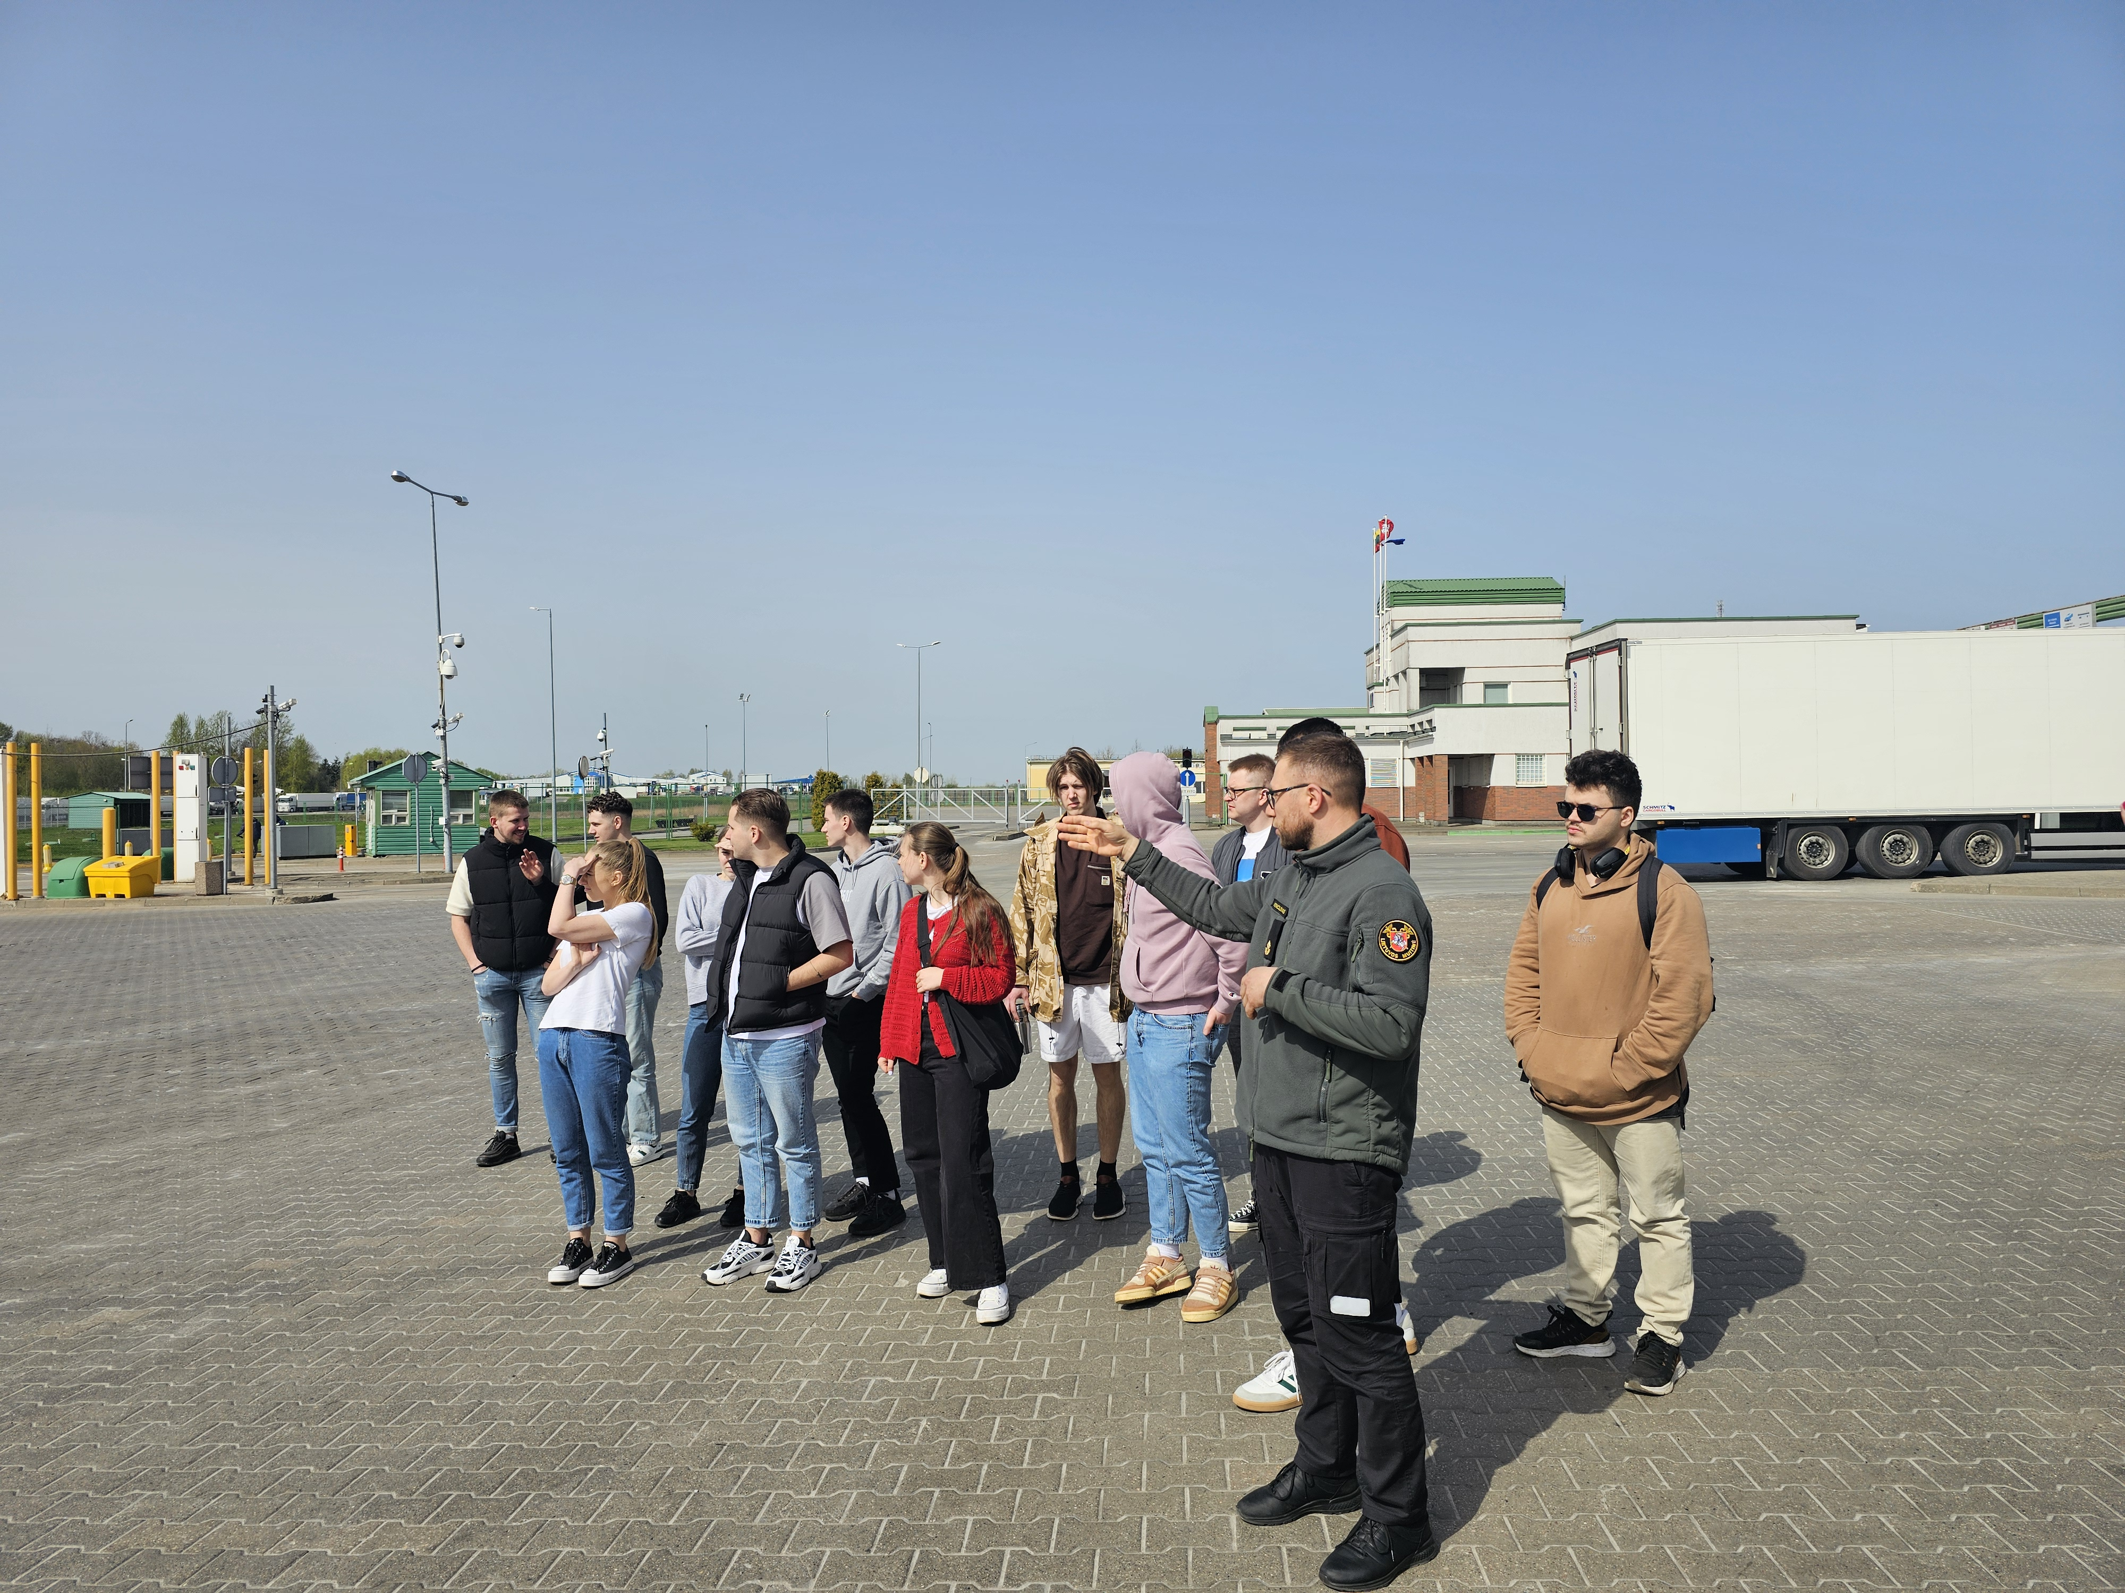
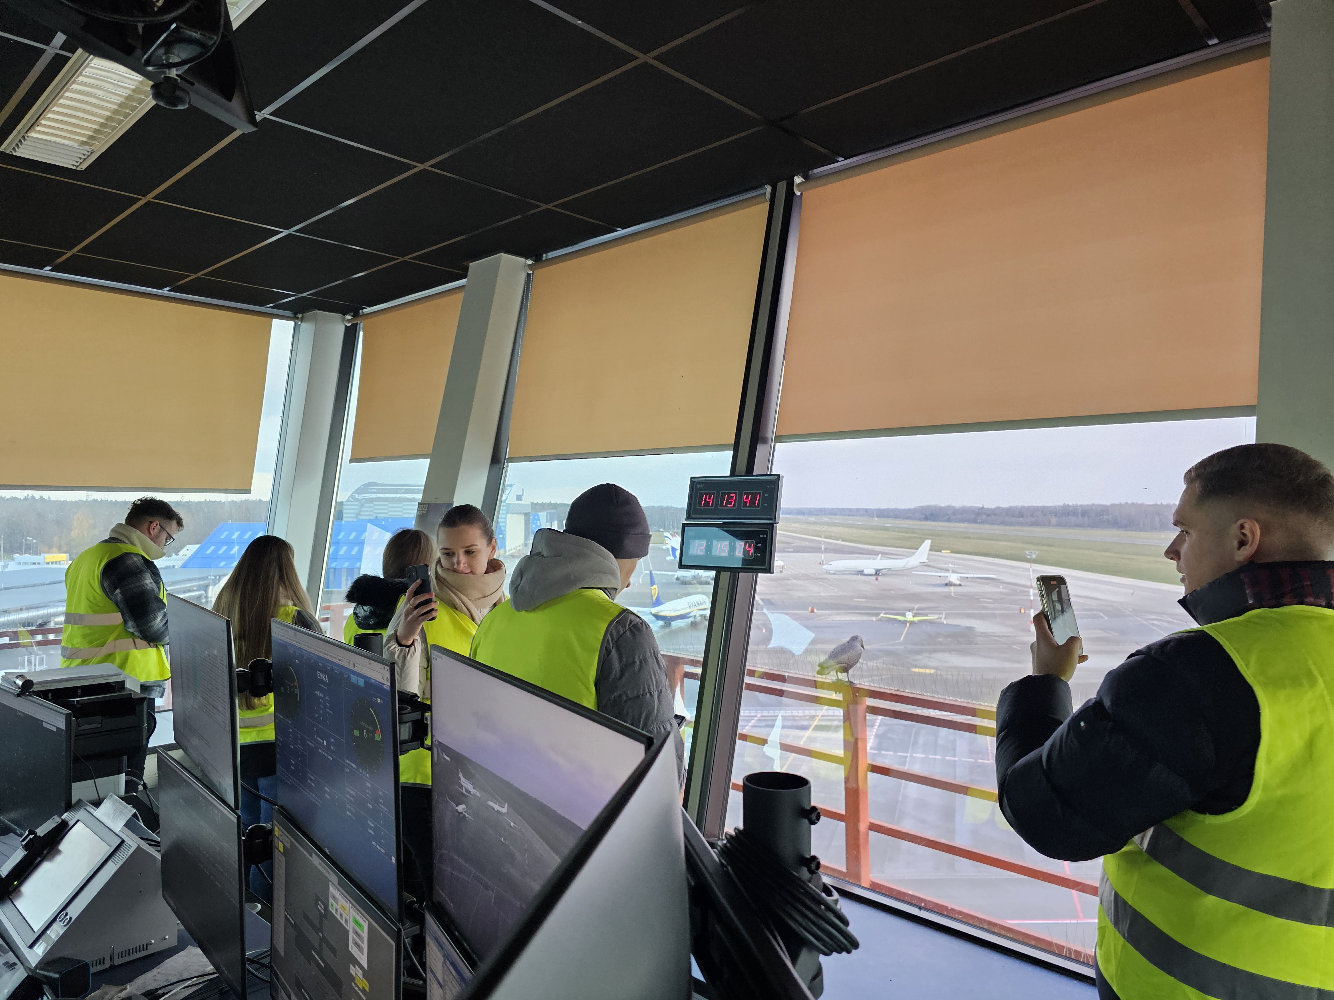
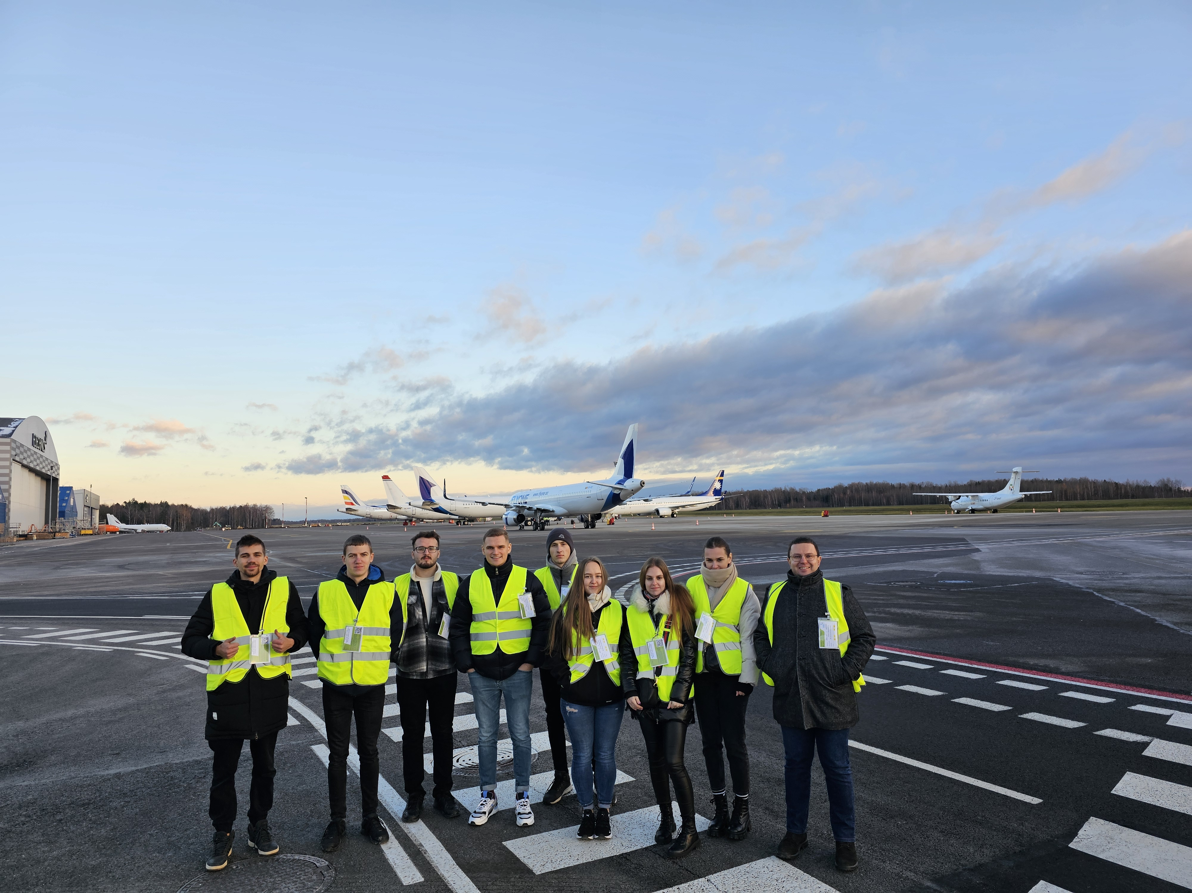
Teaching based on Experience, Real life cases and Practical knowledge
Notes:
S

Slide 8
Reda Mikalauskaite
Head of International Relations office
Reda.mikalauskaite@smk.lt
Daiva Lunienė Study Program Coordinator
daiva.luniene@smk.lt Tomas Tamulevičius Lecturer tomas.tamulevicius@dest.smk.lt
www.smk.lt
Youtube: SMK Aukštoji mokykla
Facebook: @SMKUniversity​
Instagram: @smklife​
Notes:
We invite you for conscious learning together

