Slide 1
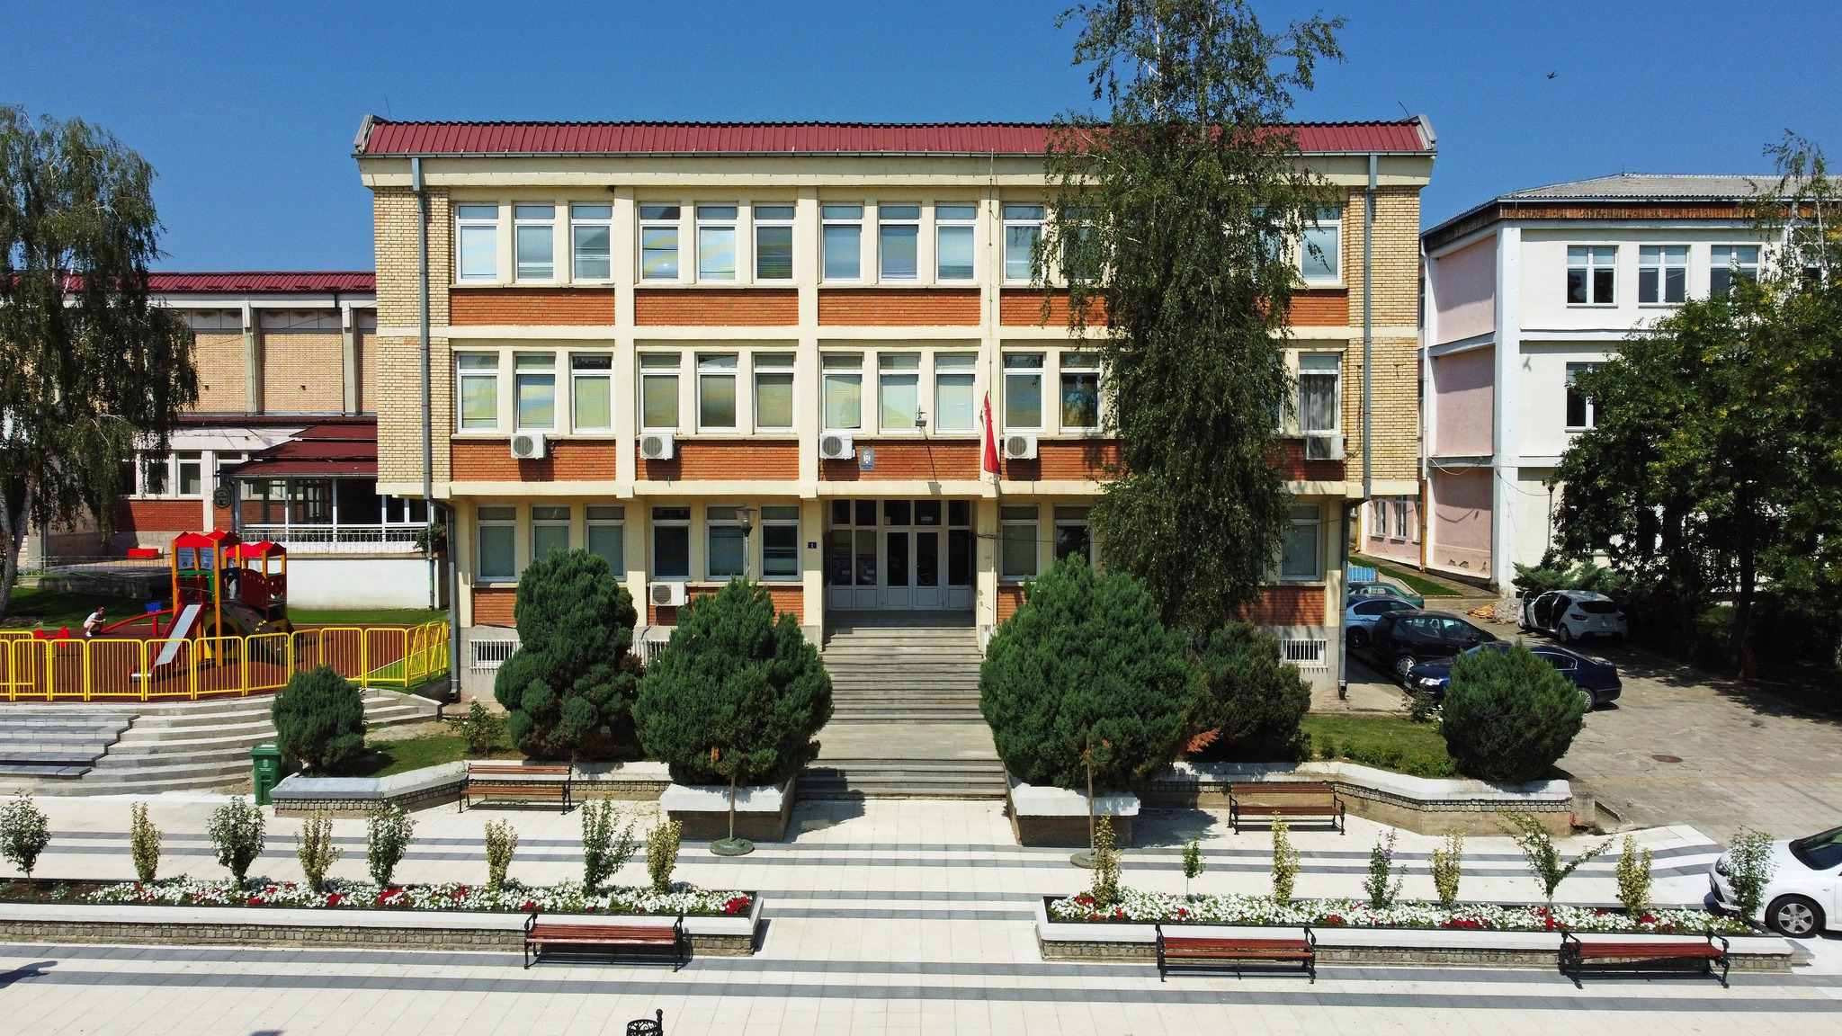
STUDY PROGRAM
TAXES AND CUSTOMS
GORAN PERIĆ
BOJAN VASOVIĆ
MARIJA STOJILJKOVIĆ

Slide 2
ABOUT DEPARTMENT
01
The Department of Business Studies in Blace carries out its educational activities as part of the Toplica Academy of Applied Studies, an independent state-funded high education institution.
The Department itself has a 65-year tradition in higher education and conducts bachelor’s, specialist’s, and master’s applied studies in the social-humanistic and technical-technological sciences. Study programs (in the fields of economics, management, tourism and hotel management, computing and informatics) are accredited by the competent authorities of the Republic of Serbia by the Law on Higher Education.
For 25 years, the Department has been successfully implementing the study program Taxes and Customs, which is one of the most attractive programs in the Department.
The study program Taxes and Customs was reaccredited in 2024 by the National Entity for Accreditation and Quality Assurance in Higher Education (NEAQA).
The Department achieves successful cooperation with the Customs Administration, the Tax Administration, customs brokers, shipping and forwarding companies.

Slide 3
ABOUT STUDY PROGRAM
02
The aim of Taxes and Customs bachelor applied studies is to provide students with the opportunity to acquire and improve knowledge, as well as to develop creative abilities and specific practical skills necessary for performing tasks in tax and customs business.
The program lasts three years, i.e. six semesters, after which the student receives 180 ECTS credits. The program consists of compulsory and elective study courses, professional practice 1 and 2, the research methodology for final thesis, and the final thesis.
During the second and the third year, students perform professional practice in:
The Tax Administration, branches and tax calculation and collection branches;
The Customs Administration, directorates, customs offices, reports and sections for the control of customs goods where students perform the tasks of implementing the customs procedure, calculating and collecting import and other duties, detecting customs offences, keeping records and statistical data on traffic, import, export and other customs affairs;
Forwarding companies and free zones;
Customs brokers and other companies dealing with import and export.

Slide 4
CURRICULUM
03
First year
 | Code | Compulsory Study Courses | ECTS
1. | 24.OPU01 | Basics of Economics | 6
2. | 24.OPU02 | Management | 6
3. | 24.OPU03 | Financial Accounting | 6
4. | 24.OPU04 | Business Informatics | 6
5. | 24.OPU05 | English 1 | 6
6. | 24.OPU06 | Basics of Marketing | 6
7. | 24.OPU07 | Business Economics | 6
8. | 24.OPU08 | Statistics | 6
9. | 24.OPU09 | Business Communications | 6
10. | 24.OPI01 | Elective Study Courses 1 (1 of 2) | 6
 | 24.OPU10 | Digital Skills
 | 24.OPU11 | Innovation and Competition

Slide 5
CURRICULUM
04
Second year
 | Code | Compulsory Study Courses | ECTS
11. | 24.OPU12 | Business Law | 7
12. | 24.OFR01 | Monetary and Public Finance | 6
13. | 24.OPC01 | E - government | 7
14. | 24.OPC02 | Tax System and Policy | 7
15. | 24.OPC03 | Professional practice 1 | 3
16. | 24.OPC04 | Customs System and Policy | 6
17. | 24.OPU16 | English 2 | 6
18. | 24.OPC05 | Tax Administration and Collections | 6
19. | 24.OPCI2 | Elective Study Courses 2 (1 of 2) | 6
 | 24.OP105 | Marketing of Financial Services
 | 24.OPC06 | Control and Audit
20. | 24.OPCI3 | Elective Study Courses 3 (1 of 2) | 6
 | 24.OP106 | Capital Economics and Development Financing
 | 24.OP102 | Entrepreneurship

Slide 6
CURRICULUM
05
Third year
 | Code | Compulsory Study Courses | ECTS
21. | 24.OPCI4 | Elective Study Courses 4 (1 of 2) | 7
 | 24.OPC07 | Logistics
 | 24.OPU17 | E – commerce
22. | 24.OPC08 | Customs Business, Procedures and Processes | 6
23. | 24.OPC09 | International Business | 7
24. | 24.OPC10 | Tax Accounting | 6
25. | 24.OPC11 | Professional practice 2 | 3
26. | 24.OPCI5 | Elective Study Courses 5 (1 of 2) | 6
 | 24.OPC12 | Financing Local Government
 | 24.OP104 | Management Information System
27. | 24.OPC13 | International Transport, Forwarding and Insurance | 5
28. | 24.OPC14 | Administrative Law | 5
29. | 24.OPC15 | Customs Tariff and Classification | 4
30. | 24.OPC16 | Research Methodology for Final Thesis | 6
31. | 24.OPC17 | Final Thesis | 5

Slide 7
TEACHING METHODS
06
Teaching in the study program is carried out using the monologue and dialogue method, as well as the method of practical activities (practical approach in teaching), which aim to encourage students to work permanently, develop critical thinking and solve certain problems within the framework of tax and customs business.
By taking the exam, the student earns a certain number of ECTS credits, which is determined based on the student's workload. The number of ECTS credits in an individual course is determined based on the total engagement of the student: the total number of hours of active teaching and the total number of hours of active individual work of the student. For example, a course with 6 ECTS credits includes about 180 hours of work and can have 4 hours of active teaching, which means that the student spent 60 hours in active teaching and 120 hours in independent work (preparation of the colloquium, preparation of the seminar paper, preparation of the exam etc.).
An integral part of the curriculum is the professional practice in the second and the third year, lasting at least 180 hours of work in the tax and customs administration, freight forwarding, customs brokers, free zones or at companies dealing with import and export.

Slide 8
OPPORTUNITIES FOR JOINT ACTIVITIES
07
Additional improvement of the existing curriculum through elective study courses;
Exchange of experience;
Improving the way of teaching in courses specific to customs;
Improvement of the way of carrying out professional practice;
Creation of a new study program of specialist applied studies (1 year/60 ECTS) that would be fully aligned with the EU Customs Competency Framework.

Slide 9
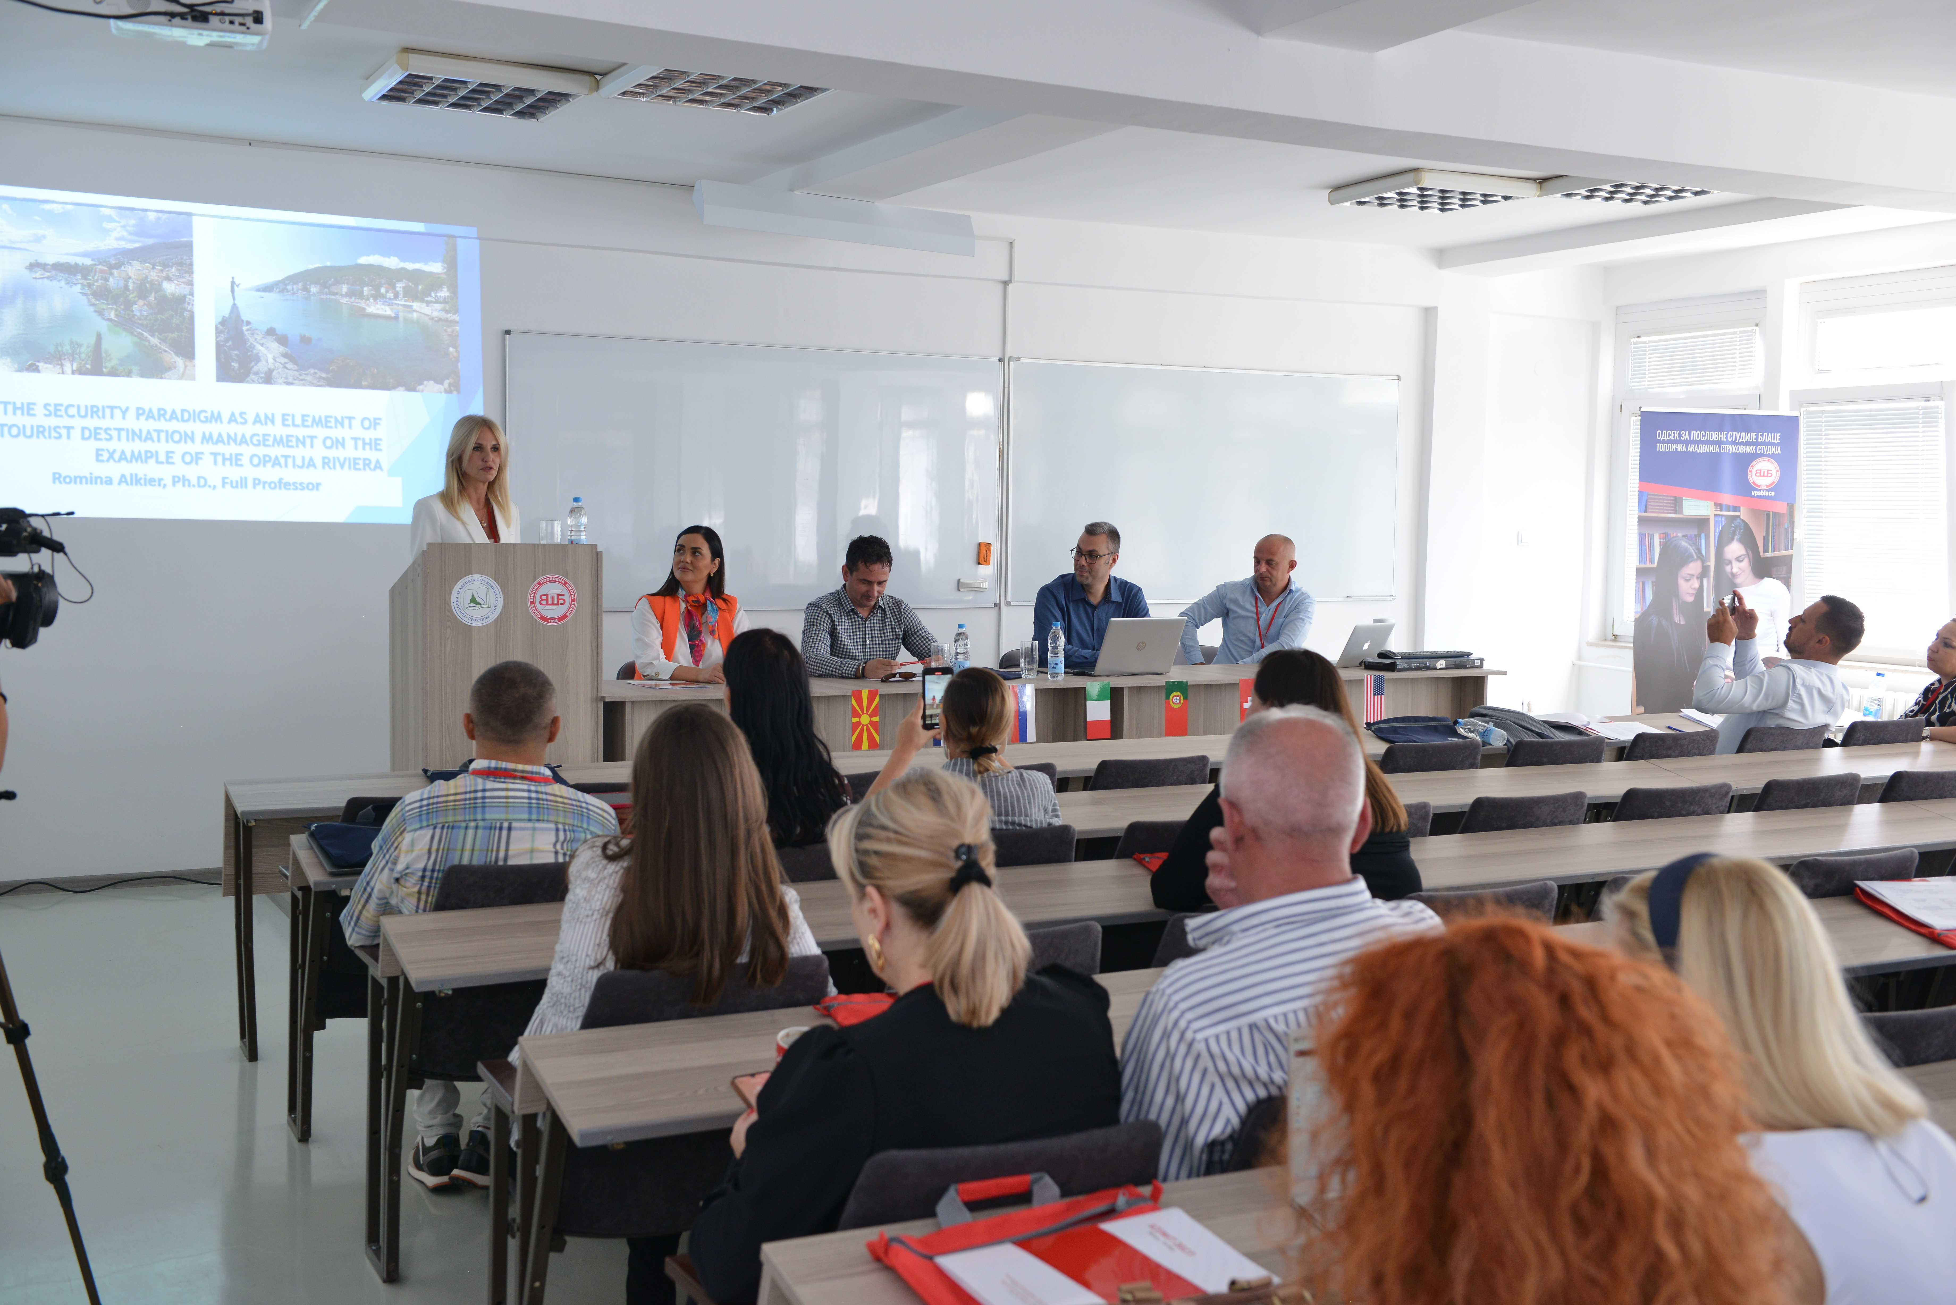
CONTACT
Kralja Petra I St., 1, Blace, 18420, Serbia
+381 27 371 377
Info@vpskp.edu.rs
@vpsblace
https://vpsblace.edu.rs/

Slide 10
THANK YOU FOR YOUR ATTENTION!

